Slide 1
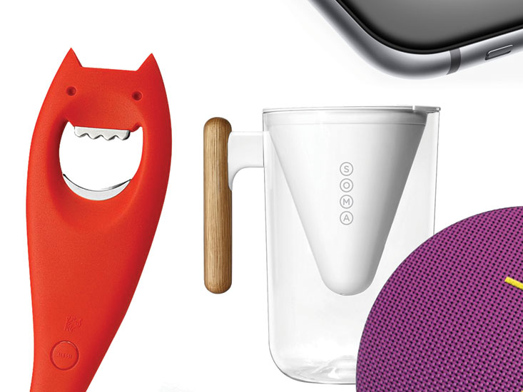
higher Design & Manufacture
Aesthetics

Slide 2


Learning intentions & success criteria
Learning Intentions
Introduction to the design factor of aesthetics.
Success Criteria
Understand and explain the design factor of aesthetics.
Use aesthetics to explain and justify your design choices.

Slide 3


What is aesthetics?
Aesthetics is:
The human perception of beauty, including:
  Sight
  Smell
  Sound
  Touch
  Taste
  Movement
It is more than just how things look!

Slide 4
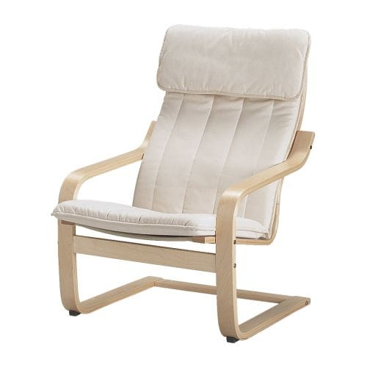
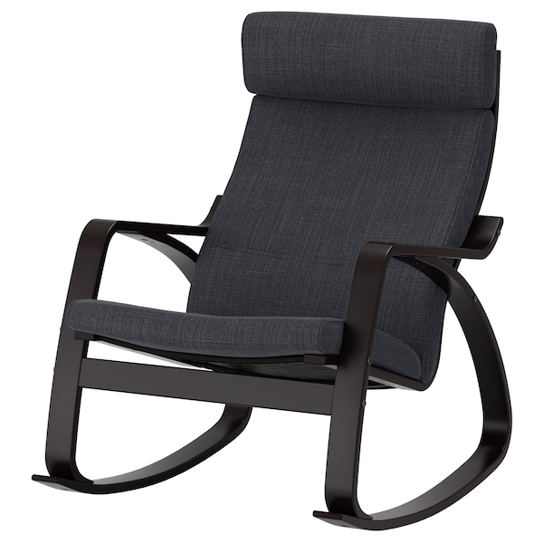
What is aesthetics?
There are many different factors that influence aesthetics…
  Line/Shape/Form
  Colour
  Size/Proportion
  Contrast/Harmony
  Fashion/Style/Trends
  Materials
  Texture

Slide 5
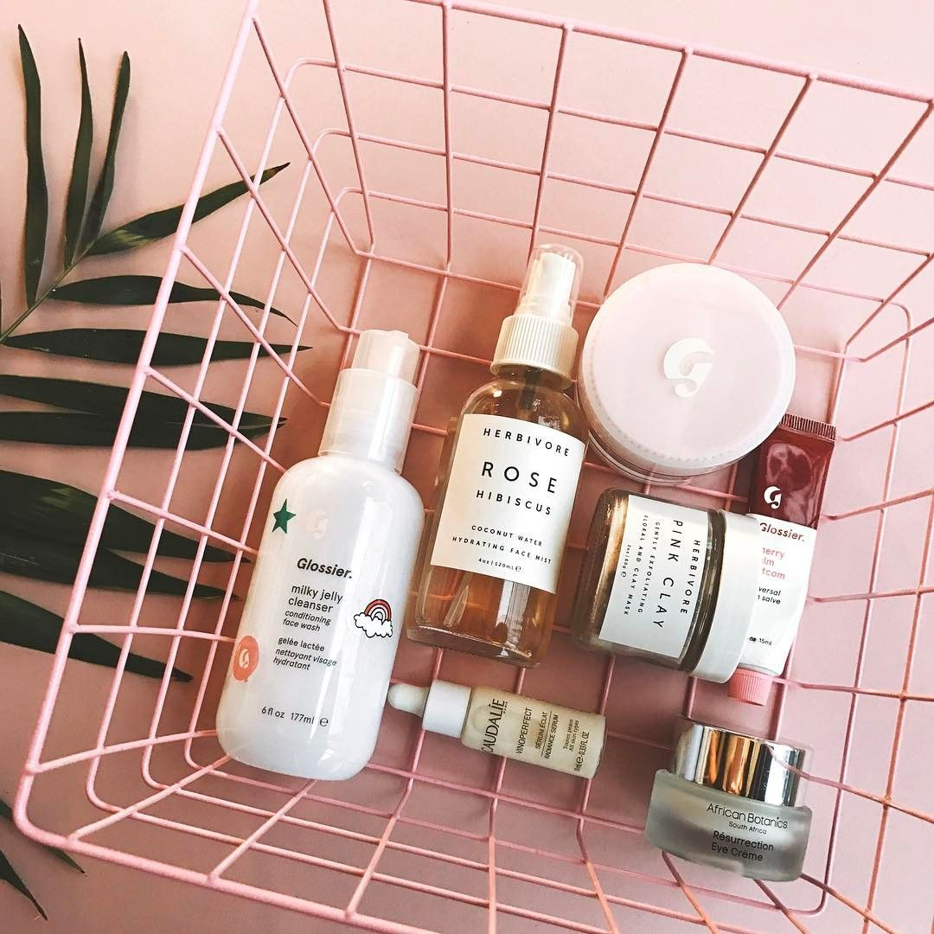
What is aesthetics?
A product’s aesthetics can alter the user’s experience and perception of a product in several ways, some of which can be subconscious.
Designers can use aesthetics to make products more:
  Attractive
  Safer
  Easier to use
Designers therefore need to have an understanding of:
  The elements that affect aesthetics
  How to apply them
  The impact they have on consumer perceptions

Slide 6

How to people develop aesthetics?
For example, a baby is a blank canvas as far as their preferences for aesthetics are concerned.
As they grow, they naturally develop and find themselves drawn to things they find attractive and pleasing, such as they look, smell, feel or sound of, for example, a toy.
These early aesthetic preferences are based on emotional responses.
Aesthetic Preference is therefore subjective.

Slide 7
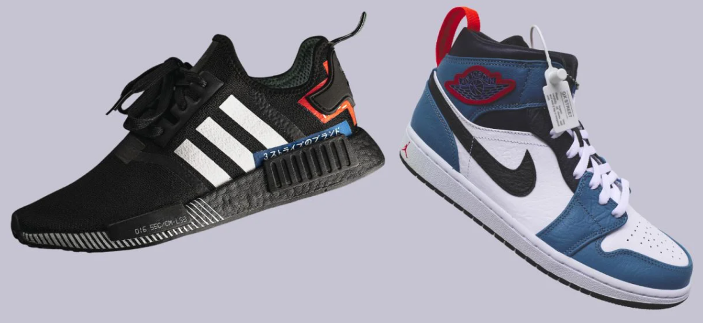
WHICH DO YOU PREFER AND WHY?

Slide 8

How do people develop aesthetics?
Our preferences for particular aesthetics allow us to communicate aspects of our:
  Identity
  Personality
  Style
These are rooted in our social and emotional needs.

Slide 9
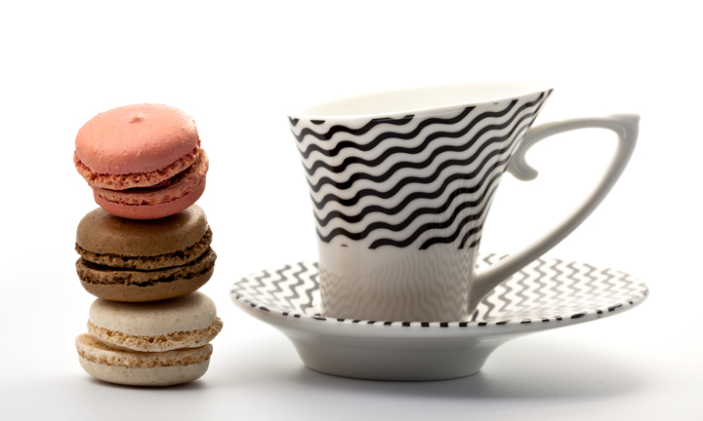
How do people develop aesthetics?
As people grow older, their experience of the world and the products around them gives them appreciation and understanding of design.
This matures as they begin to consider aesthetics on a deeper level.

Slide 10

How do people develop aesthetics?
Aesthetics may influence perception of other aspects of the product such as:
  Does it appear to be easy to use?
  Does it feel as though is it good quality?
  Is it good value?
  Does it appear to be safe?

Slide 11
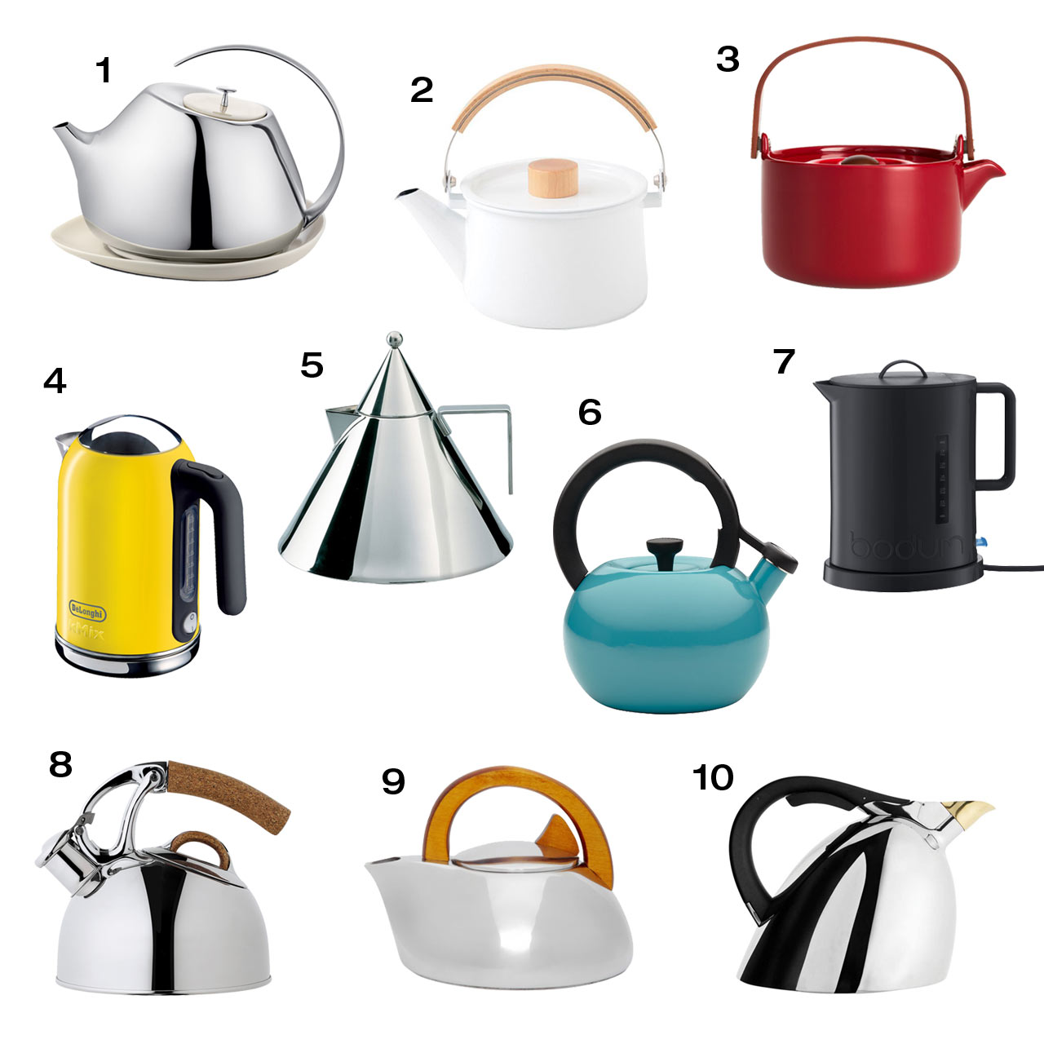
Application of aesthetics in design
In today’s global market, aesthetics can be used to distinguish products from others in the market.
Changing aesthetic elements will impact other design materials and texture factors and vice versa. e.g. material.

Slide 12

Application of aesthetics in design
It is important the designer creates the correct aesthetic to appeal to the target market.
They can check this by carrying out market research.
To be effective, market research must address the appropriate aesthetic elements.

Slide 13
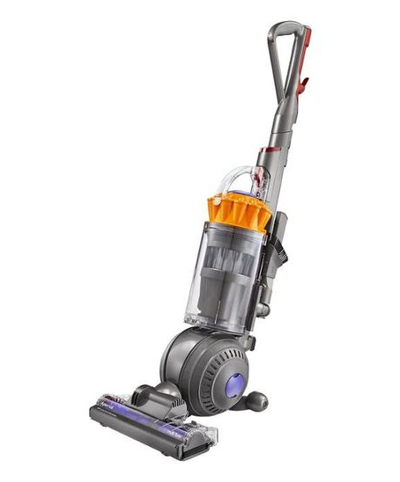
example
Aesthetics has a big impact on how people perceive a product.
For example…
The form of the Dyson makes it look well built and technologically advanced.
The grey colour makes it appear machine-like suggesting it will perform efficiently.
The yellow contrasts and draws attention to the key components of the product.
The transparent material surrounding the cyclone draws your focus to the central component.
The product looks balanced and poised suggesting it is easy to manoeuvre.

Slide 14
Some terms used to describe aesthetics are given in the table.
Copy out the table below to use as a word bank in the future.
Visual | Sound | Tactile | Smell | Taste
Colour | Pitch | Texture | Strength | Texture
Shape/Form | Tone | Weight | Bitter | Bitter
Line | Volume | Comfort | Sweet | Sweet
Symmetry | Repetition | Temperature | Sour | Sour
Pattern | Quality | Form | Pleasantness | Pleasantness
Proportion |  | Quality |  | Strength
Balance
Materials

Slide 15
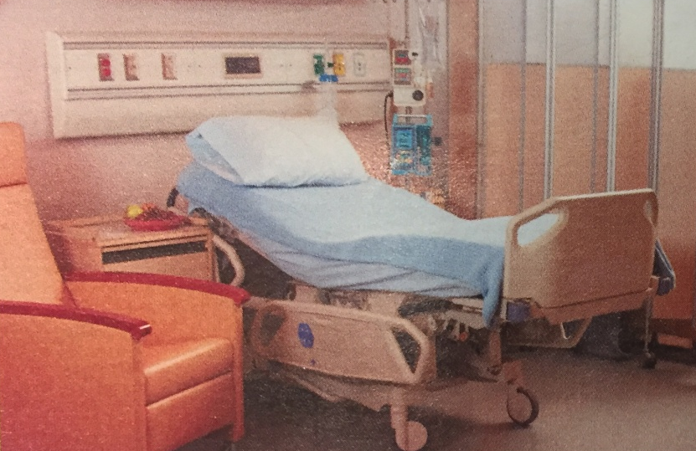

Task 1
Look at the two images with beds on the left.
Compare the impact of the aesthetics for the users in the two rooms using some key words from your table.
For example: the cream colour of walls and furniture adds warmth to the hospital room.
Visual | Sound | Tactile | Smell | Taste
Colour | Pitch | Texture | Strength | Texture
Shape/Form | Tone | Weight | Bitter | Bitter
Line | Volume | Comfort | Sweet | Sweet
Symmetry | Repetition | Temperature | Sour | Sour
Pattern | Quality | Form | Pleasantness | Pleasantness
Proportion |  | Quality |  | Strength
Balance
Materials

Slide 16
Answers 1
Visual, colour
  Cream of walls and furniture adds warmth to the hospital room.
  Both rooms a mixture of the same warm and cool colours.
  This is more comforting than a sterile white room.
  The blue bed cover stands out, making this the dominant feature in the room.
  In the second room the blue colour is used in the rug to create a sense of space and in the pillows to add decoration.
  A crisp white is used, creating a fresh feel.
Visual, shape and line
  There are a lot of contrasting shapes and used in the hospital room, including the furniture and walls. This makes the room very busy and potentially unsettling for the patient.
  The bedroom uses mainly squares, creating an orderly look.
  The contrasting curve of the headboard and the curved edges of the bedside furniture creates a more relaxed feel.

Slide 17
Answers 2
Visual Symmetry
  The bedroom symmetry reinforces the neat orderly look.
  There is no symmetry in the hospital room; it is packed with equipment.
Sound
  There is potentially a lot of noise from the items in the hospital room and the machines.
  This could be unsettling for the patient.
  The bedroom is more likely to be quiet and an intimate space.
Smell
All hospitals have a smell from chemicals, cleaning materials and furniture.
The bedroom would be more relaxing for the user as it would smell more familiar
Tactile, texture
  Many of the surfaces in the hospital room are smooth, making them hygienic and easy to wipe clean.
  The bedroom textures are softer and more comfortable.

Slide 18
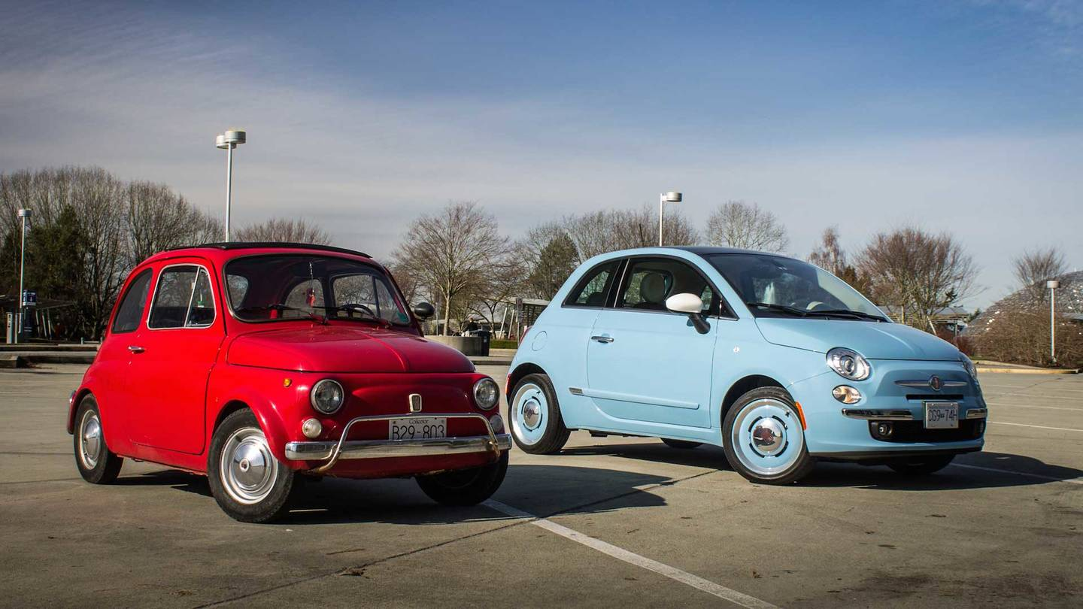
Task 2
Evaluating the aesthetic characteristics of products will develop your understanding of how design decisions alter the appearance and our perception of products
Compare the aesthetic appeal of the Fiat 500s shown below.
  How have the aesthetics evolved over time?
  Use the table you have copied out to help you describe.
  Consider why both cars might be appealing today.
  Think about all aesthetic elements that are relevant.

Slide 19
Answers 1
The shape of the Fiat 500 has evolved over time.
It has gradually becomes more curvy as the transition between the bonnet and the roof is now more subtle an angle.
The modern Fiat 500 is larger than early models.
Use of line is evident in both cars: alignment between the bottom of the windows and the height of the bonnet.
In the new model, a contrasting black has been used in the edges of the windows to create an illusion of more defined, sharper windows.
Pattern has been used to add interest and perceived value to the wheels.
The bumpers of the wheels to the car has changed over time. Wheels have become bigger, giving a better look overall.

Slide 20
Answers 2
Metal on the older car is dull, whereas a high polished chrome is used in the new Fiat. This creates a higher perceived value.
New-car smell is appealing to some consumers. The used smell of a vintage car may not appeal to some.
Engine noise also influences users. Some might want a quiet drive and others prefer to hear the sound of the engines. The older car may produce noises which reduce the confidence they have in driving it as well as safety.
The older car may be appealing today as people like to have vintage products, either as nostalgic things or because they like the aesthetic appeal of vintage products.
The new car may be more appealing because of its colour and size.

Slide 21
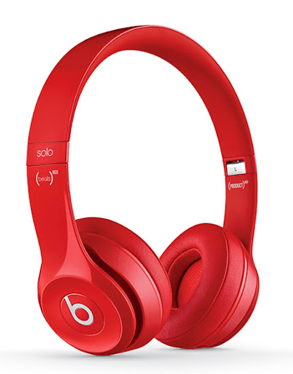
Task 3
Aesthetic Product Analysis
Analyse the aesthetic characteristics of a product of your choice.
Use a series of quick annotated sketches to illustrate how the aesthetics of the product impact the following:
      Function of the product
      Aesthetics of the product

Slide 22
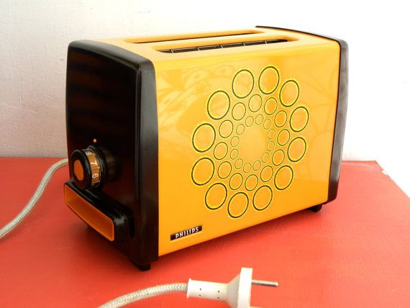
Task 4
Any change we make to a design will alter the product’s aesthetics in some way. Make changes to the toaster shown below that will:
Improve the function by making the toast easier to remove
  Make it easier to clean
  Make it easier to manufacture
  Increase the stability of the product
  Make it safer to use
  Use a separate sketch for each change
Annotate the sketches to explain the changes.

Slide 23
Question
8 marks
Designers frequently consider aesthetics as an important factor in the development of new products.
Explain how aspects of aesthetics have influenced the design of products that you are familiar with.
(You may refer to more than one product in your answer.)

